Slide 1

Bangladesh Army University of Engineering & Technology Department of Electrical & Electronic Engineering
Lecture: 01 - 03
Course Code: EEE 1261
Course Title: Electronic Devices and Circuits
Course Teacher: Ferdous Farjana
Designation: Lecturer, Dept. of EEE, BAUET

Slide 2
Outline
Material: Conductor, Semiconductor, Insulator
Valence Band & Conduction Band
Band/Energy Gap
Drift Velocity
Drift Current
Fermi Level or Fermi Energy
Bonds in Semiconductor
Semiconductor Types: Intrinsic & Extrinsic
P-Type Material or P-Type Semiconductor
N-Type Material or N-Type Semiconductor
Majority & Minority Carriers
P-N Junction
Depletion Region/Layer
P-N Junction Diode Under No Bias
P-N Junction Diode Under Forward Bias
P-N Junction Diode Under Reverse Bias

Slide 3
Material: Conductor
Material:
Material is the substance or substances of which a thing is made or composed.
It can be divided into three types which are:
Conductor:
The conductor is a substance which allows the electric current to pass through it easily.
Example: All metals, Copper (Cu), Aluminum (Al), Gold (Au), Silver (Ag), etc.

Slide 4
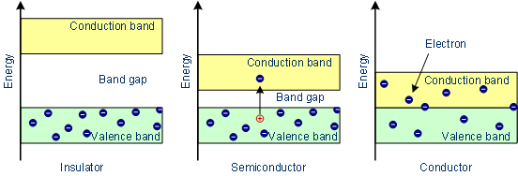
Material: Conductor
In the conductor, there is no forbidden gap available.
Band gap represents the minimum energy difference between the top of the valence band and the bottom of the conduction band.
The valence band and conduction band overlap each other.
The electrons from the valence band freely enter into the conduction band.
Due to the overlapping of the valence and conduction bands, a very low potential difference can cause the continuous flow of current.
Fig. 1: Energy band in conductor.

Slide 5
Material: Semiconductor
Semiconductor:
The semiconductor is a material which has a conductivity of electric current between conductors and non-conductors or insulators.
Example: Germanium (Ge), Silicon (Si), GaAs, etc.
In semiconductors, the forbidden gap is very small.
Ge & Si are the best examples of semiconductors.
Fig. 2: Energy band in semiconductor.

Slide 6
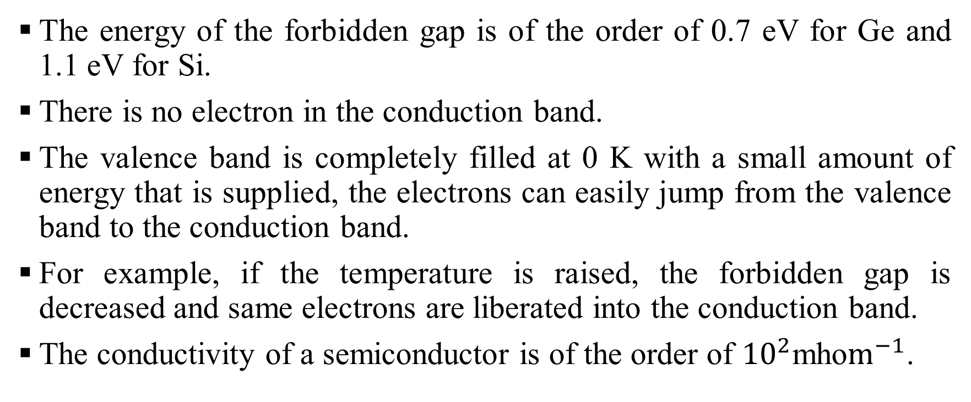
Material: Semiconductor
The energy of the forbidden gap is of the order of 0.7 eV for Ge and 1.1 eV for Si.
There is no electron in the conduction band.
The valence band is completely filled at 0 K with a small amount of energy that is supplied, the electrons can easily jump from the valence band to the conduction band.
For example, if the temperature is raised, the forbidden gap is decreased and same electrons are liberated into the conduction band.
The conductivity of a semiconductor is of the order of ${10}^{2}$mho$m^{−1}$.

Slide 7
Material: Insulator
Insulator:
The insulator is a material that does not conduct electrical current.
Example: Paper, Plastic, Rubber, Glass, Air, etc.
In an insulator, the forbidden energy gap is very large.
In general, the forbidden energy gap is more than 3 eV and almost no electrons are available for conduction.
Fig. 3: Energy band in insulator.

Slide 8
Material: Insulator
Therefore, a very large amount of energy must be supplied to a valence electron to enable it to go to the conduction band.
In case of material like glass, the valence band is completely filled at 0 K.
The energy gap between the valence band and conduction band is of the order of 10 eV.
Even in the presence of a high electric field, the electrons can not move from the valence band to the conduction band.

Slide 9
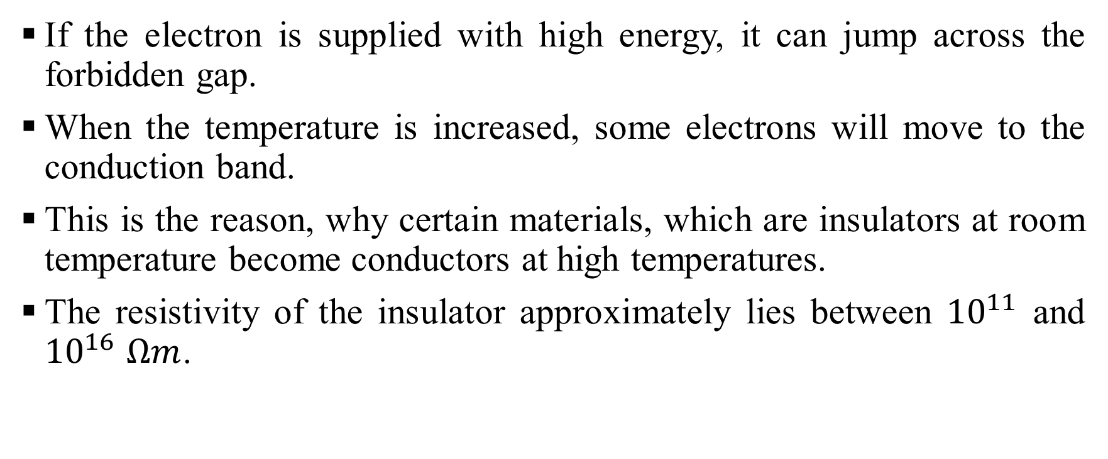
Material: Insulator
If the electron is supplied with high energy, it can jump across the forbidden gap.
When the temperature is increased, some electrons will move to the conduction band.
This is the reason, why certain materials, which are insulators at room temperature become conductors at high temperatures.
The resistivity of the insulator approximately lies between ${10}^{11}$ and ${10}^{16}$ $Ωm$.

Slide 10
Valence Band & Conduction band
Valence Band: The band which is partially or completely filled with electrons is called the valence band.
Conduction Band: The band which is empty or partially filled with electrons is called the conduction band.

Slide 11
Band/Energy Gap
The band/energy gap represents the minimum energy difference between the top of the valence band and the bottom of the conduction band.

Slide 12
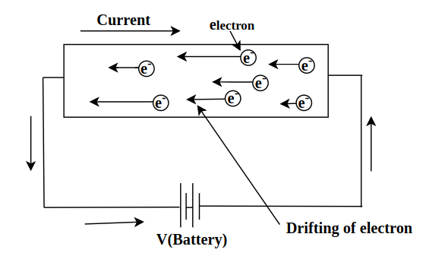
Drift Velocity
Drift velocity is defined as the velocity with which free electrons get drifted towards the positive terminal, when an electric field is applied.
Fig. 4: Drift velocity.

Slide 13
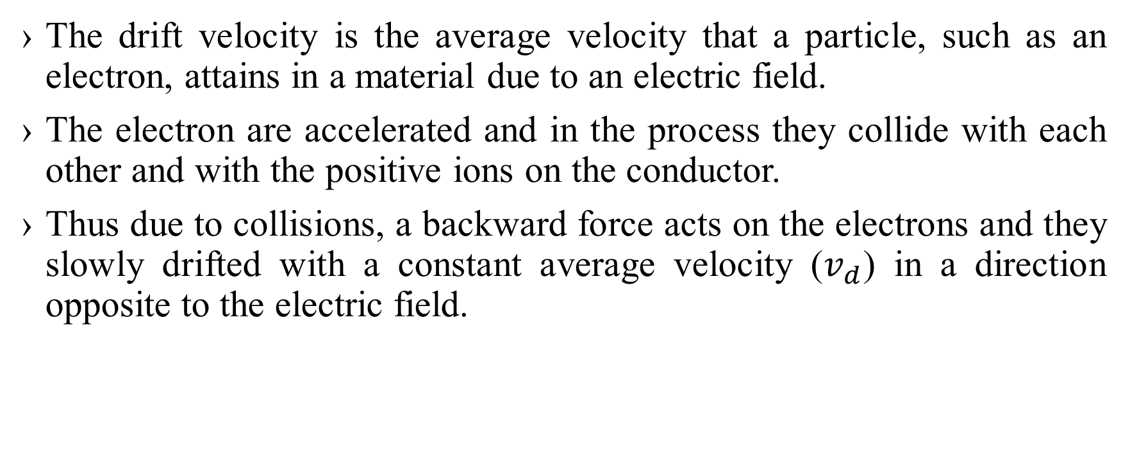
Drift Velocity
The drift velocity is the average velocity that a particle, such as an electron, attains in a material due to an electric field.
The electron are accelerated and in the process they collide with each other and with the positive ions on the conductor.
Thus due to collisions, a backward force acts on the electrons and they slowly drifted with a constant average velocity ($v_{d}$) in a direction opposite to the electric field.

Slide 14
Drift Current
When an electric field is applied across a semiconductor material, a current is produced due to the flow of charge carriers.
This current is called drift current.

Slide 15
Fermi Level or Fermi Energy
Fermi level or Fermi energy is the maximum level or energy occupied by an electron at 0 K.
The Fermi level/energy changes as the materials is warmed & electron are added or withdrawn from the materials.

Slide 16
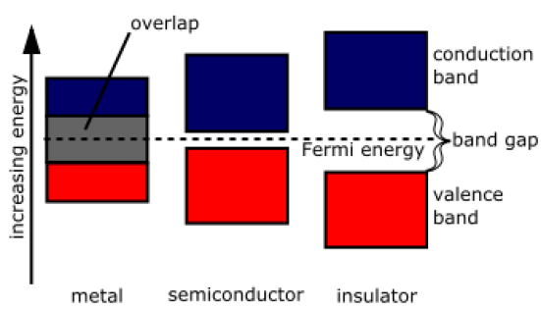
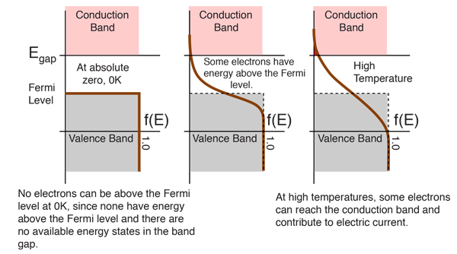
Fermi Level or Fermi Energy
(a)
(b)
Fig. 5: Fermi Level or Fermi Energy.

Slide 17
Bonds in Semiconductor
Covalent Bond:
In semiconductors, the bonds are formed by sharing of valence electrons.
Such bonds are called covalent bonds.
Si and Ge are tetravalent (Group IV) element and semiconductor.
Valence Electron: A valence electron is an outer shell electron of an atom which can participate in forming chemical bonds with other atoms.

Slide 18
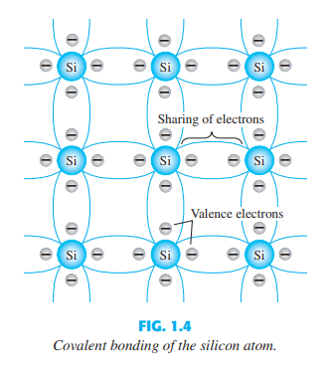
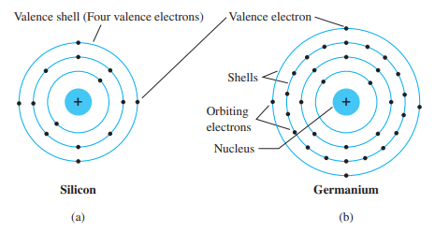
Bonds in Semiconductor
(a)
(b)
(c)
Fig. 6: Atomic structure of (a) silicon, (b) germanium, and (c) covalent bond in silicon atom.

Slide 19
Bonds in Semiconductor
Semiconductors are a special class of elements having conductivity between that of a good conductor and that of an insulator.
In general, semiconductor materials fall into one of two classes: (i) Single-crystal and (ii) Compound.
Single-crystal semiconductors are Si, Ge.
Compound semiconductors are GaAs, CdS, GaN, GaAsP.
The three semiconductors used most frequently in the construction of electronic devices are Si, Ge, and GaAs.

Slide 20
Semiconductor Types: Intrinsic & Extrinsic
Intrinsic Semiconductor:
A semiconductor in an extremely pure form is known as an intrinsic semiconductor.
Example: Si, Ge.
Extrinsic Semiconductor:
A semiconductor in which impurities are added is called an extrinsic semiconductor.
The process of adding impurities to a semiconductor is known as doping.

Slide 21
Semiconductor Types: Intrinsic & Extrinsic
The purpose of adding impurities is to increase either the number of free electrons or holes in the semiconductor crystal.
Doping increases the electrical conductivity of semiconductors.
Depending upon the type of impurity added, extrinsic semiconductors are classified into two categories:
P-type material or p-type semiconductor
N-type material or n-type semiconductor.

Slide 22
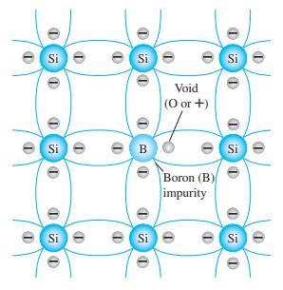
P-Type Material or P-Type Semiconductor
The p-type material or p-type semiconductor is formed by doping a pure germanium or silicon crystal with impurity atoms having three valence electrons (trivalent) such as boron (B), gallium (Ga), indium (In), aluminum (Al), etc.
The diffused impurities with three valence electrons are called acceptor atoms.
The trivalent elements are members of group III in the periodic table.
In a pure Si or Ge semiconductor, each nucleus uses its four valence electrons to form four covalent bonds with its neighbors.
Fig. 7: Boron impurity in p-type material.

Slide 23
P-Type Material or P-Type Semiconductor
So there are no excess electrons or holes in this case.
Now if one of the atoms of the Si lattice is replaced by an element with three valence electrons like B, then the electron-hole balance will be changed.
This impurity will be able to contribute three valence electrons to the lattice, therefore leaving one excess hole.
The holes will accept free electrons, so group III impurity is called an acceptor.
Because an acceptor donates excess holes, which are positively charged, a semiconductor doped with an acceptor is called a p-type semiconductor; ‘p’ stands for positive.
The resulting p-type material is electrically neutral.

Slide 24
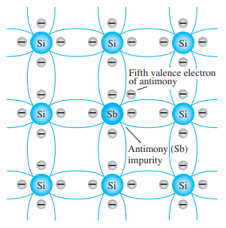
N-Type Material or N-Type Semiconductor
The n-type material or n-type semiconductor is formed by doping a pure Ge or Si with impurity atoms having five valence electrons (pentavalent) such as antimony (Sb), arsenic (As), phosphorus (P), nitrogen (N), etc.
The diffused impurities with five valence electrons are called donor atoms.
The pentavalent elements are members of group V in the periodic table.
In a pure Si or Ge semiconductor, each nucleus uses its four valence electrons to form four covalent bonds with its neighbors.
Fig. 8: Antimony impurity in n-type material.

Slide 25
N-Type Material or N-Type Semiconductor
So there are no excess electrons or holes in this case.
Now if one of the atoms of the Si lattice is replaced by an element with five valence electrons like Sb, then the electron-hole balance will be changed.
This impurity will be able to contribute four valence electrons to the lattice, therefore leaving one excess electron.
Because it donates an electron, a group V impurity is called a donor.
Donor impurities donate negatively charged electrons to the lattice, so a semiconductor doped with a donor is called an n-type semiconductor; ‘n’ stands for negative.
The resulting n-type material is electrically neutral because the number of protons in the nucleus and the number of free electrons remain the same.

Slide 26
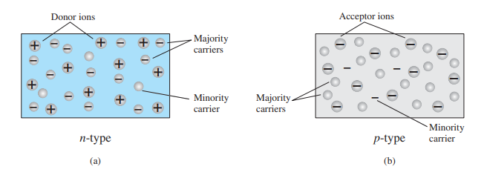
Majority & Minority Carriers
In a p-type material, the hole is the majority carrier and the electron is the minority carrier.
In an n-type material, the electron is called the majority carrier and the hole is the minority carrier.
Fig. 9: (a) n-type material; (b) p-type material.

Slide 27
P-N Junction
When a p-type semiconductor is suitably joined to a n-type semiconductor, the contact surface is called a P-N junction.

Slide 28
Depletion Region/Layer
The region of uncovered positive and negative ions is called the depletion region due to the “depletion” of free carriers in the region of a P-N junction.

Slide 29
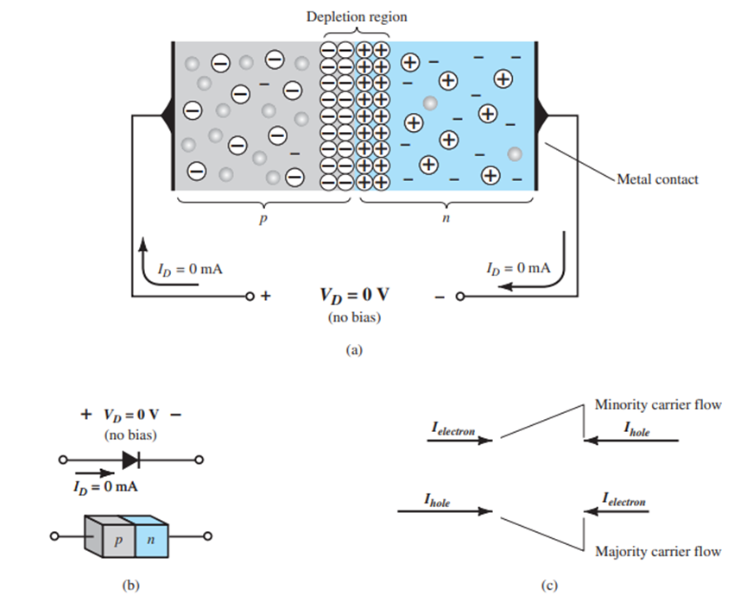

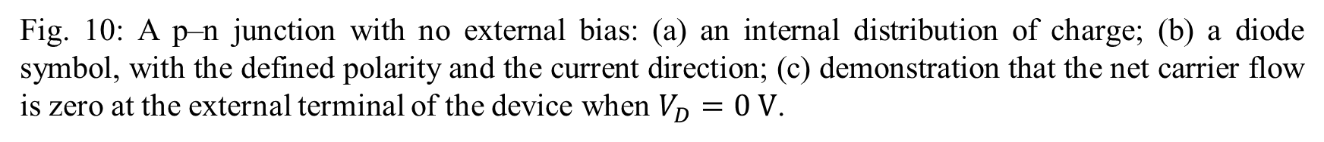
P-N Junction Diode Under No Bias ($V_{D}=0$)
Fig. 10: A p–n junction with no external bias: (a) an internal distribution of charge; (b) a diode symbol, with the defined polarity and the current direction; (c) demonstration that the net carrier flow is zero at the external terminal of the device when $V_{D}=0 V$.

Slide 30
P-N Junction Diode Under No Bias ($V_{D}=0$)
When a diode is connected in a zero-bias condition, no external voltage potential is applied to the p-n junction diode.
Any minority carrier (hole) of n-type materials finds themselves within the depletion region and passes quickly to the p-type material.
The closer the minority carrier is to the junction, the greater the attraction for negative ions in the layer, and the less the opposition offered by positive ions in the layer of p-type material.
Similarly, the minority carrier (electron) will also pass quickly to the n-type material and find themselves in the depletion region.
The electrons and holes in the depletion region attract each other.

Slide 31
P-N Junction Diode Under No Bias ($V_{D}=0$)
Since there is a large number of majority carriers so, they pass through the depletion region.
Electrons in the n-type material start to flow currents in the diode, known as forward current.
Similarly, holes in the p-type material also start to flow currents in the opposite direction, known as reverse current.
Potential barriers in the depletion region oppose the migration of electrons and holes across the junction and as a result, a state of equilibrium is established.
So, a net zero current flows in the junction diode.

Slide 32
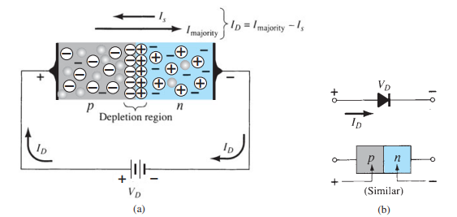

P-N Junction Diode Under Forward Bias ($V_{D}>0$)
Fig. 11: Forward-biased p–n junction: (a) internal distribution of charge under forward-bias conditions; (b) forward-bias polarity and direction of resulting current.

Slide 33
P-N Junction Diode Under Forward Bias ($V_{D}>0$)
When the positive potential is connected to the p-type material and the negative potential is connected to the n-type material then forward bias is established.
The minority carrier of p-type material (electron) and the minority carrier of n-type material (hole) flow to each other in the depletion region.
The majority carrier (hole) of p-type material and the positive terminal of the battery repel each other.
So the majority carrier will flow to the n-type material.
Similarly, the majority carrier (electron) of n-type material and the negative terminal of the battery repel each other.

Slide 34
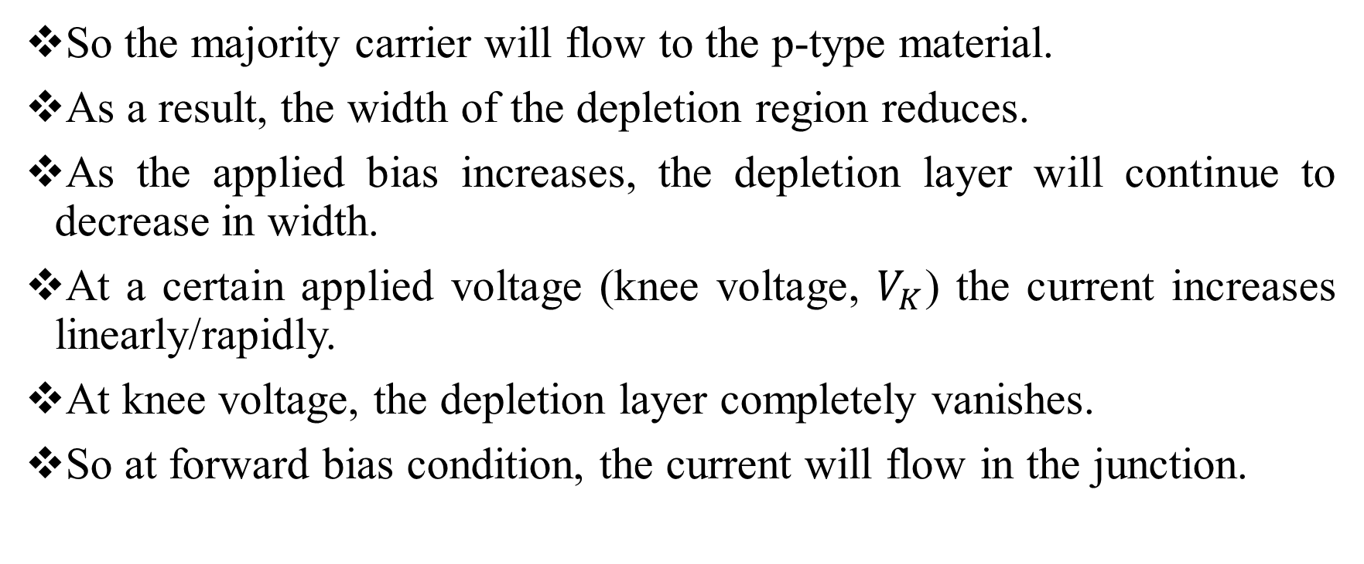
P-N Junction Diode Under Forward Bias ($V_{D}>0$)
So the majority carrier will flow to the p-type material.
As a result, the width of the depletion region reduces.
As the applied bias increases, the depletion layer will continue to decrease in width.
At a certain applied voltage (knee voltage, $V_{K}$) the current increases linearly/rapidly.
At knee voltage, the depletion layer completely vanishes.
So at forward bias condition, the current will flow in the junction.

Slide 35
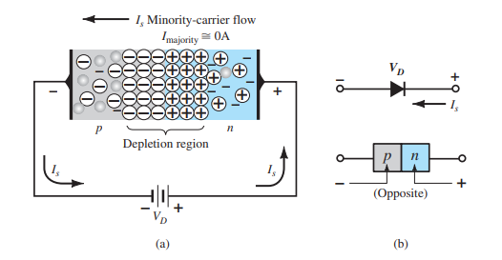

P-N Junction Diode Under Reverse Bias ($V_{D}<0$)
Fig. 12: Reverse-biased p–n junction: (a) internal distribution of charge under reverse-bias conditions; (b) reverse-bias polarity and direction of reverse saturation current.

Slide 36
P-N Junction Diode Under Reverse Bias ($V_{D}<0$)
When the negative potential is connected to the p-type material and the positive potential is connected to the n-type material then reverse bias is established.
The majority carrier (hole) of p-type material and the negative terminal of the battery attract each other.
As a result, a large number of minority carriers flow to the n-type material in the depletion layer.
Similarly, the majority carrier (electron) of n-type material and the positive terminal of the battery attract each other.
As a result, a large number of minority carriers flow to the p-type material in the depletion layer.

Slide 37
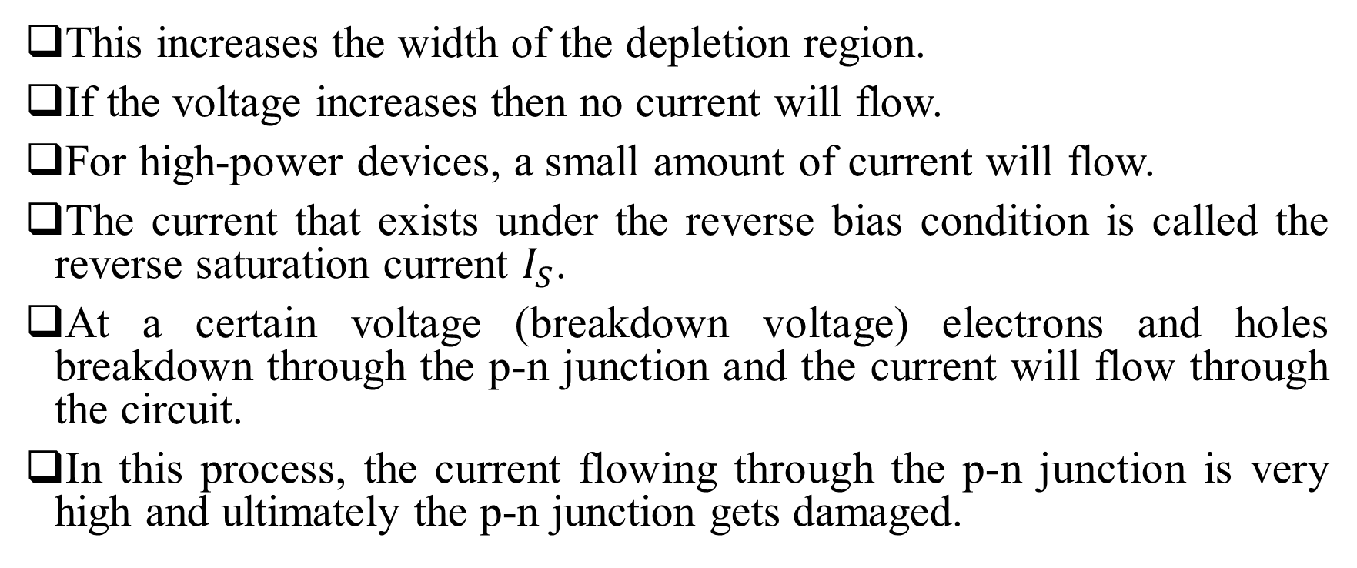
P-N Junction Diode Under Reverse Bias ($V_{D}<0$)
This increases the width of the depletion region.
If the voltage increases then no current will flow.
For high-power devices, a small amount of current will flow.
The current that exists under the reverse bias condition is called the reverse saturation current $I_{S}$.
At a certain voltage (breakdown voltage) electrons and holes breakdown through the p-n junction and the current will flow through the circuit.
In this process, the current flowing through the p-n junction is very high and ultimately the p-n junction gets damaged.

Slide 38
Reference Books
Electronic Devices and Circuit Theory: Robert L. Boylestad.
Microelectronic Circuits: Sedra Smith.
Electronic Devices and Circuits: Millman and Halkias.

Slide 39

THANK YOU

